Slide 1
E-commerce Product Analysis Using Machine Learning
Anuriya Raveendran
DA & DS
26-05-2025

Slide 2
INTRODUCTION
The e-commerce industry is rapidly expanding with thousands of products listed daily.
Businesses must understand customer preferences and market trends to remain competitive.
Objective: Use data science to enhance product offerings and optimize marketing strategies.
Tools used: Python, BeautifulSoup, Selenium, SQLAlchemy, XGBoost.

Slide 3
PROJECT WORKFLOW
Data Collection
Exploratory Data Analysis (EDA)
Data Storage (Using SQLAlchemy)
Clustering (Unsupervised Learning)
Classification (Supervised Learning)
Hyperparameter Tuning
Data Cleaning

Slide 4
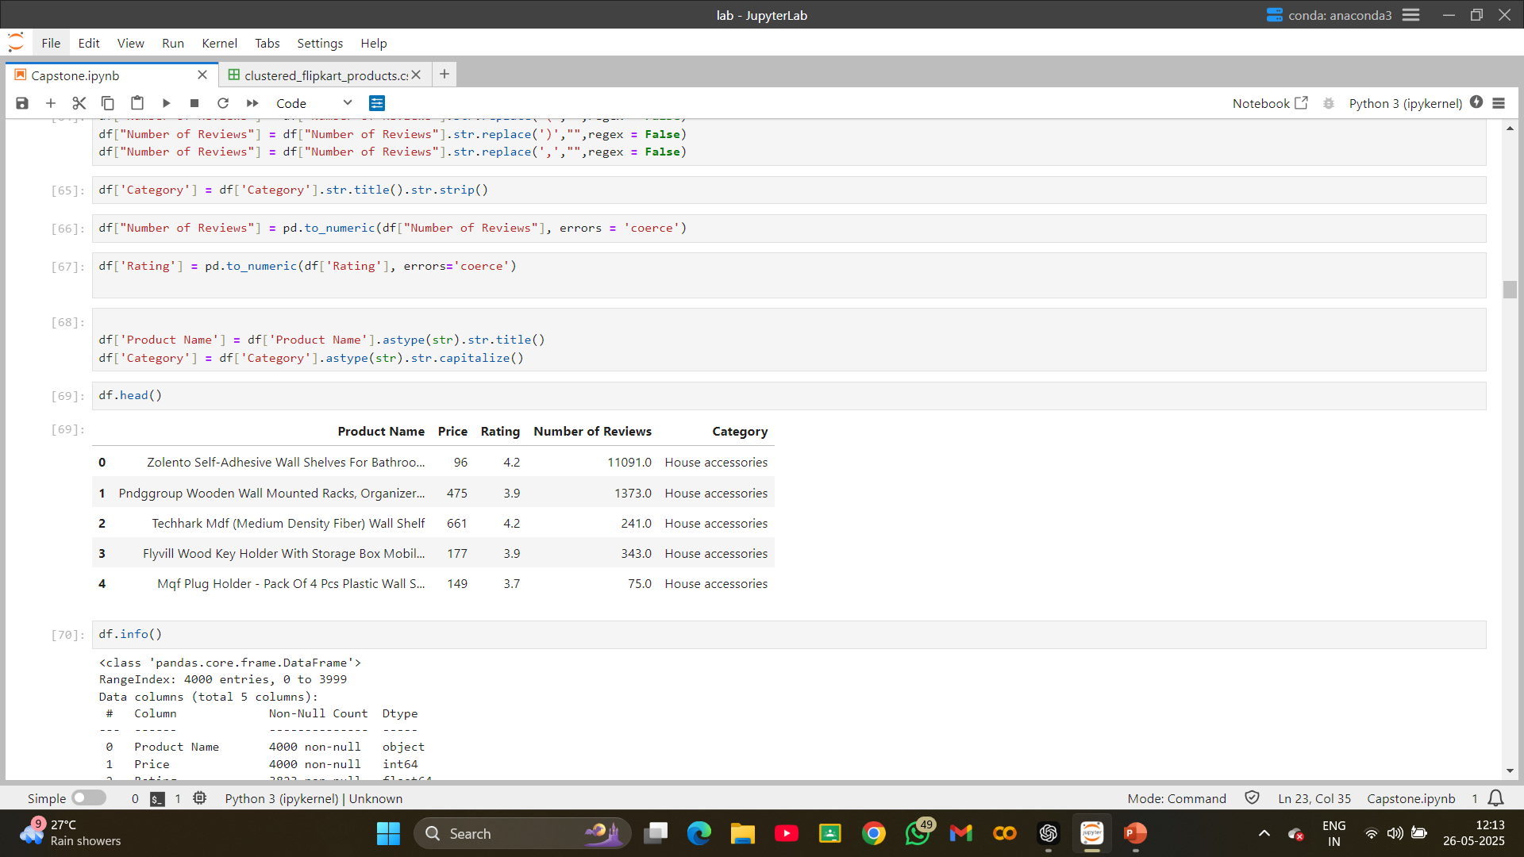
Data Collection
Source: Flipkart (Web Scraping)
Tools: Selenium, BeautifulSoup
Extracted Attributes:
Product Name
Price
Rating
Number of Reviews
Category
Categories Scraped:
House Accessories
Books
Beauty Products
Office Supplies
Pages Scraped per Category: 25
Output: Individual CSV files per category, then combined into a single dataset.

Slide 5
Data Cleaning
Library Used: Pandas
Cleaning Tasks:
Standardized price and rating fields
Converted text formats (lowercase, trimmed whitespaces)
Removing Outliers
Result: Clean, consistent dataset ready for analysis

Slide 6
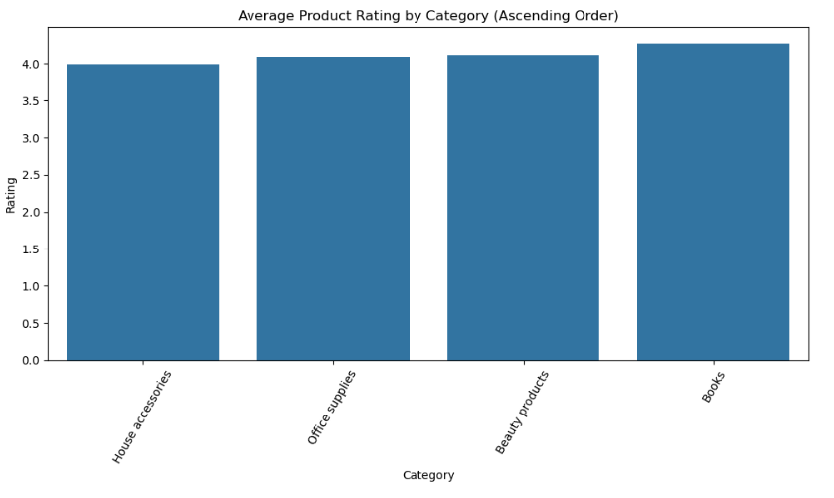
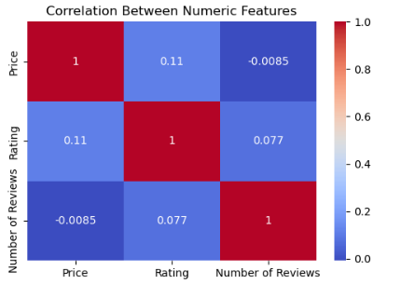
Exploratory Data Analysis (EDA)

Slide 7
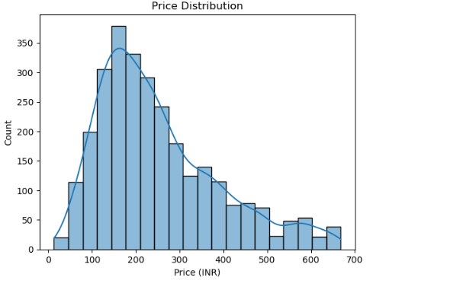
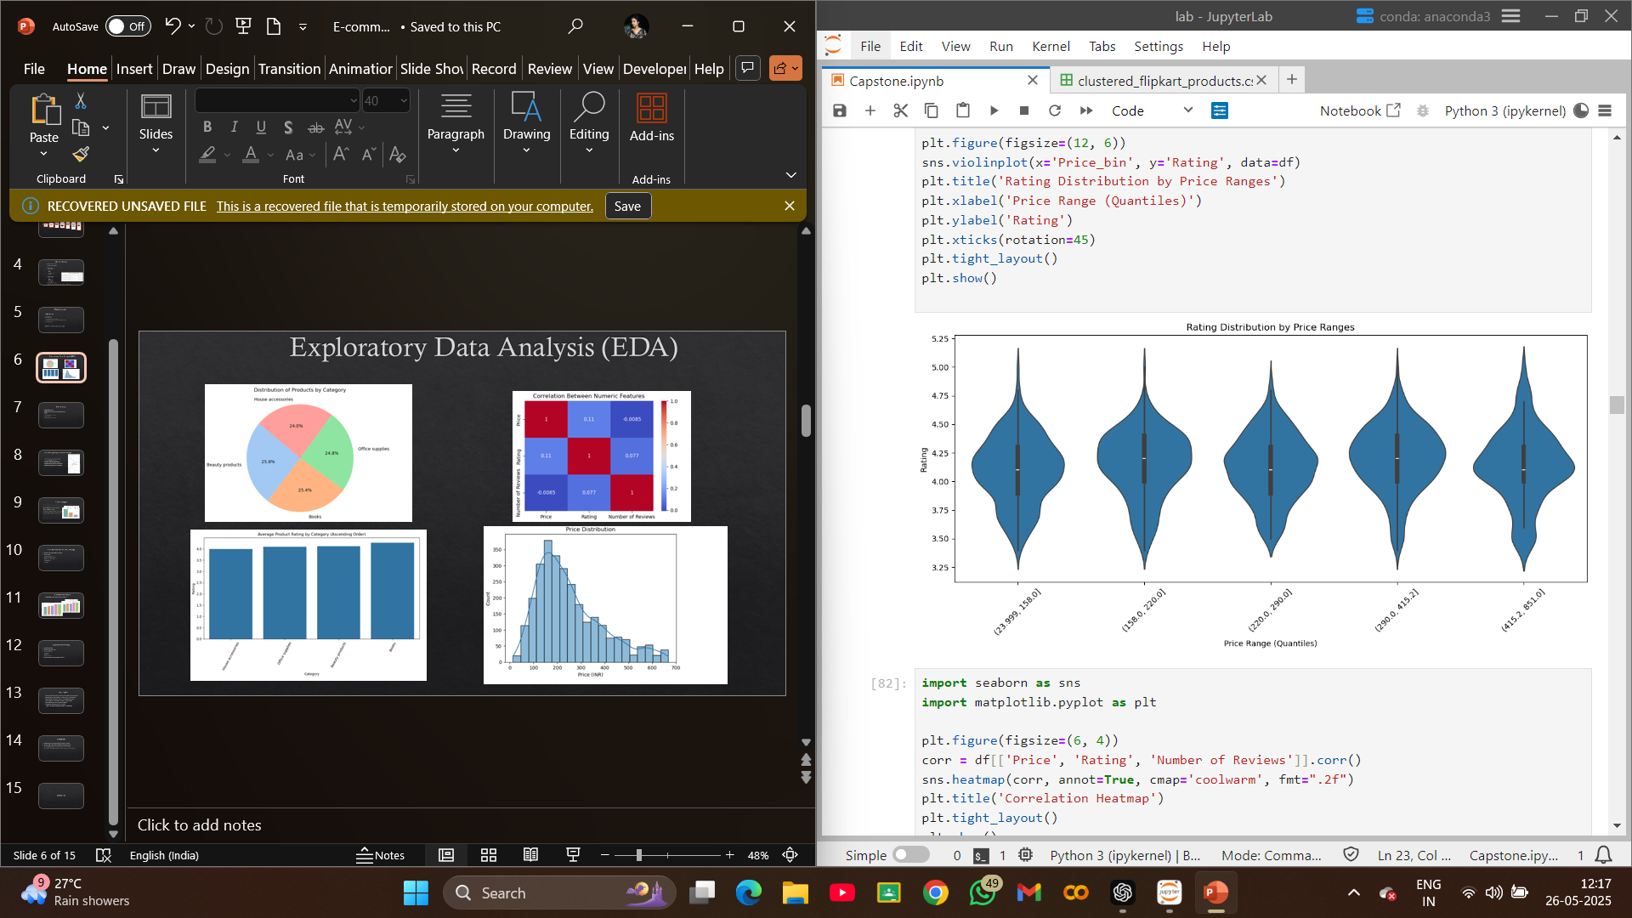
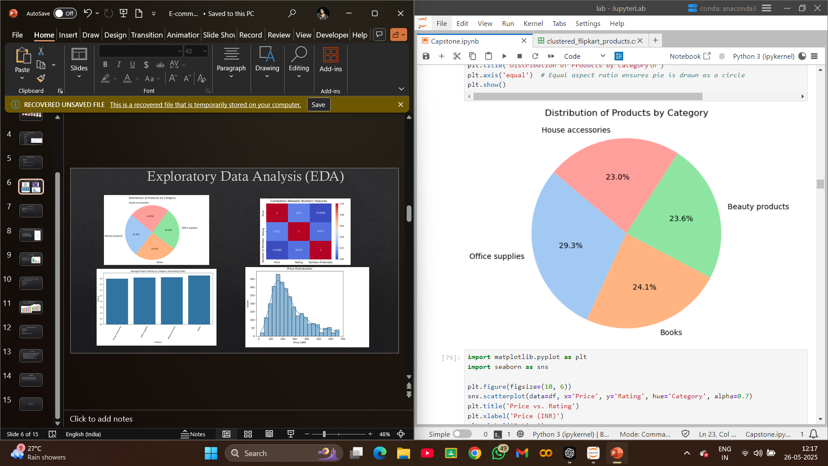

Slide 8
Data Storage
Tool Used: SQLAlchemy
Storage: Cleaned data stored in a relational SQL database
Benefits:
Structured access for modeling
Persistent storage
Efficient querying and retrieval

Slide 9
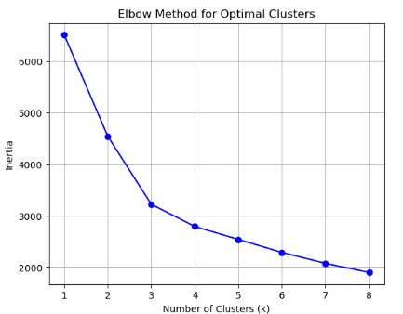
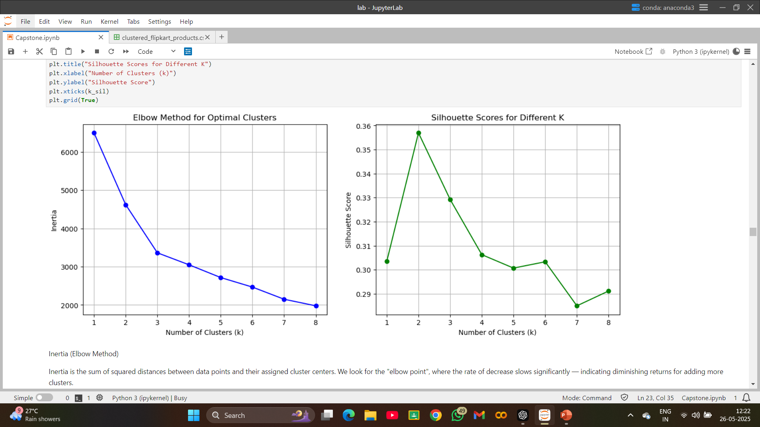
Clustering (Unsupervised Learning)
Goal: Group products based on similarity
Algorithm: K-Means Clustering
Preprocessing: Scaled numerical features
Elbow Method: Optimal clusters found at k=3
Outcome: New column for cluster assignment

Slide 10
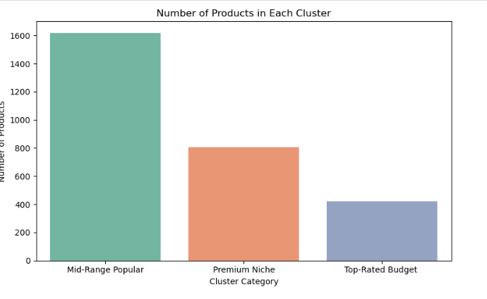
Cluster Insights
Cluster 0: Low-price, low-reviewed products
Cluster 1: Mid-range products
Cluster 2: Highly rated and reviewed premium items
Use Case: Segment-based pricing, recommendations

Slide 11
Classification (Supervised Learning)
Objective: Predict product category from features
Models Applied:
Logistic Regression
Support Vector Machine (SVM)
K-Nearest Neighbors (KNN)
Random Forest
XGBoost

Slide 12
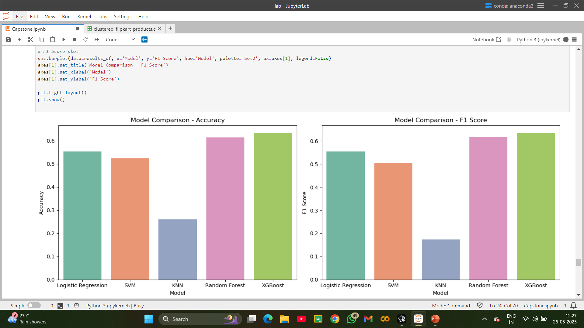
Classification Results
Top Performer: XGBoost (Best balanced performance)

Slide 13
Hyperparameter Tuning
Model Tuned: XGBoost
Technique Used: GridSearchCV
Parameters Optimized:
n_estimators
max_depth
min_samples_split
Result: Improved performance and reduced overfitting

Slide 14
Key Insights
Books have the highest rating (4.28) and most reviews (461K) → Strong customer trust
Beauty Products are well-rated (4.11) with solid engagement → Good market fit
House Accessories have lowest rating (3.99) → Needs quality improvement
Office Supplies are balanced in price and rating → Stable performance
Higher-rated products tend to be slightly more expensive
Customers are willing to pay more for better quality
Action: Consider dynamic pricing and bundling for low-rated products

Slide 15
Conclusion
Project covered web scraping, data cleaning, EDA, and ML modeling
Provided valuable insights into product quality and customer preferences
Models can help automate product categorization and decision-making
Outcome: Real-world application of data science for smarter e-commerce strategies

Slide 16
Thank You

